Slide 2
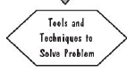
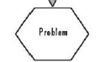
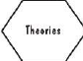
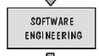
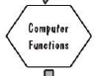
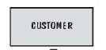

CA-Connect the objects in right way

Slide 4
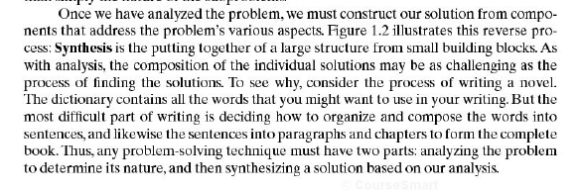

Slide 6
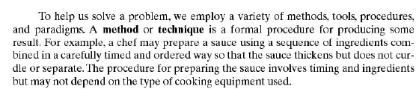

Slide 7
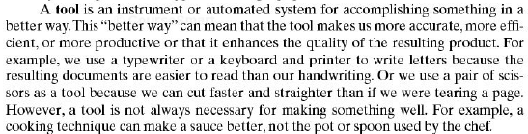

Slide 8
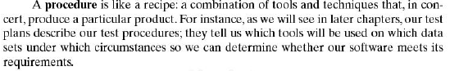

Slide 9
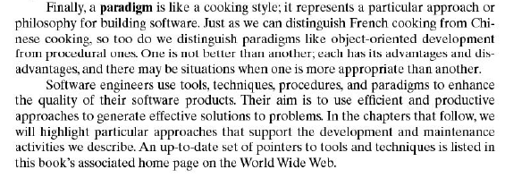

Slide 15
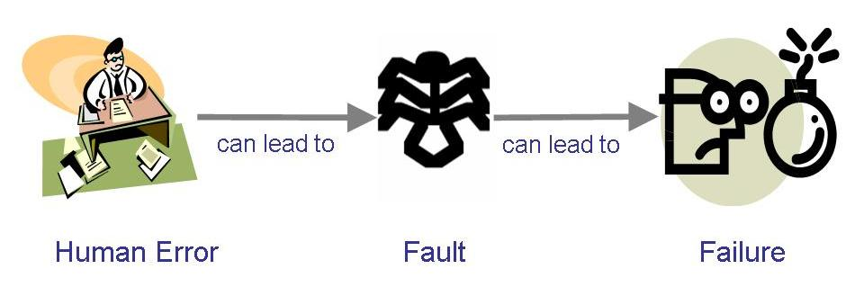
Sidebar: Terminology for Describing Bugs
A fault: occurs when a human makes a mistake, called an error, in performing some software activities
A failure: is a departure from the system’s required behaviour

Slide 17
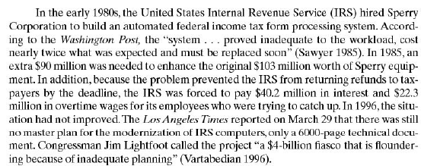
Read the failure story

Slide 19
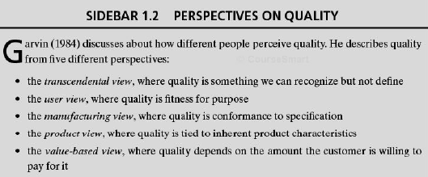

Slide 21
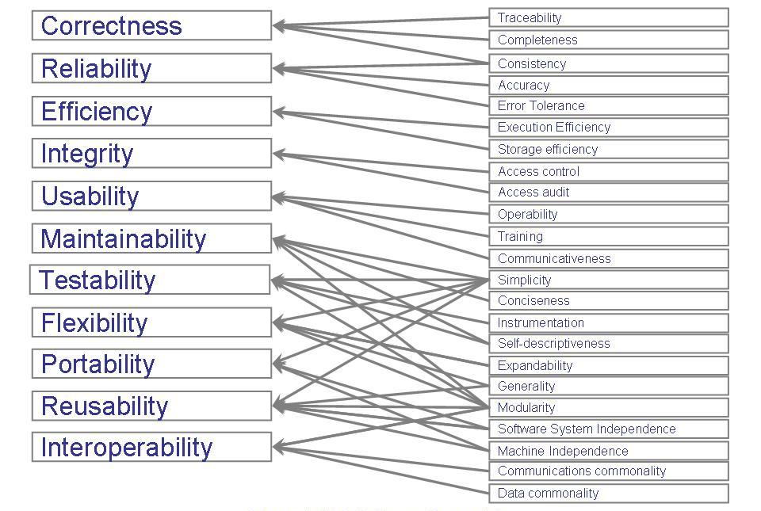
What is a Good Software Product?
McCall’s Quality Model

Slide 22
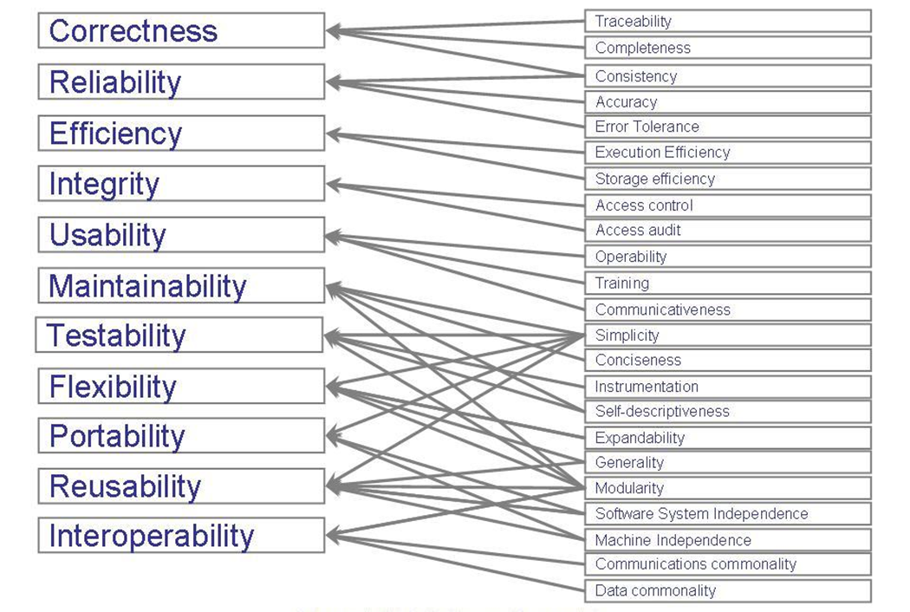

Slide 24
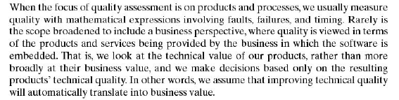

Slide 28
Why is SE Needed?
Computers everywhere
Toaster, Microwave, Temperature control of A/C, Router, Surgical Equipment…
Computers need to be managed
Software runs on all computers
Make lives comfortable, efficient, effective…
SE practices ensure development of good software to improve our living standard

Slide 29
Why Do We Need to Study SE?
What could be the benefits?

Slide 30
What is a Good Software Product?
Good software engineering must always include a strategy for producing quality software
Product Quality?
Multiple facets…

Slide 31
What is a Good Software Product?
Users judge external characteristics (e.g., correct functionality, number of failures, type of failures)
Designers and maintainers judge internal characteristics (e.g., ease of modification)
Thus different stakeholders may have different criteria
Need quality models to relate the user’s external view to developer’s internal view

Slide 32
What is a Good Software Product?
McCall’s Quality Model

Slide 33
Quality of Process
Quality of the development and maintenance process is as important as the product quality
The development process needs to be modeled
Modeling will address questions such as
Where to find a particular kind of fault
How to find faults early
How to build in fault tolerance
What are alternative activities
Models for process improvement
SEI’s Capability Maturity Model (CMM)
ISO 9000
Software Process Improvement and Capability dEtermination (SPICE)

Slide 34
Quality in Context of Business Environment
Business value is as important as technical value
Business value (in relationship to technical value) must be quantified
A common approach: return on investment (ROI) – what is given up for other purposes
ROI is interpreted in different terms: reducing costs, predicting savings, improving productivity, and costs (efforts and resources)

Slide 35
How Successful Have We Been
Perform tasks more quickly and effectively
Word processing, spreadsheets, e-mail
Support advances in medicine, agriculture, transportation, multimedia education, and most other industries
Many good stories
However, software is not without problems

Slide 36
How Successful Have We Been
IRS hired Sperry Corporation to build an automated federal income tax form processing system
An extra $90 M was needed to enhance the original $103 product
IRS lost $40.2 M on interests and $22.3 M in overtime wages because refunds were not returned on time
Malfunctioning code in Therac-25 killed several people
Reliability constraints have caused cancellation of many safety critical systems
Safety-critical: something whose failure poses a threat to life or health

Slide 37
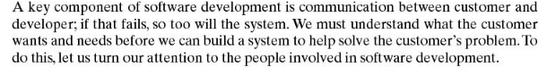
Who Does Software Engineering?

Slide 38
Who Does Software Engineering?
Customer: the company, organization, or person who pays for the software system
Developer: the company, organization, or person who is building the software system
User: the person or people who will actually use the system

Slide 39
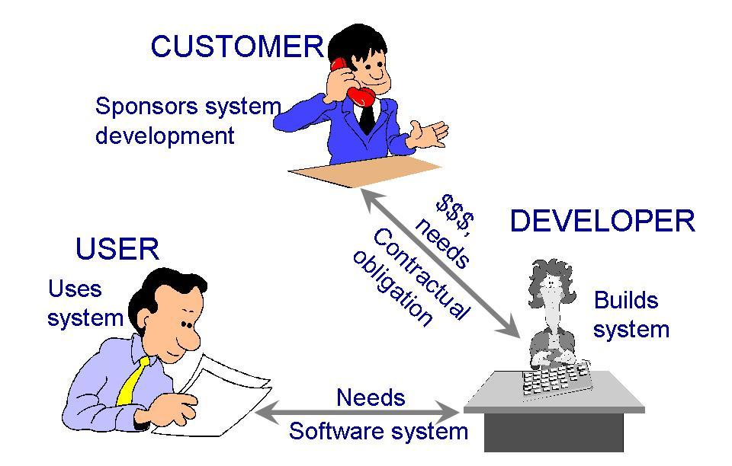
Who Does Software Engineering?
Participants (stakeholders) in a software development project
Common Of The Shelf (COTS)
Sub-contractors
Turnkey System

Slide 40
A Systems Approach
Hardware/Software
People
Interactions

Slide 41
A Systems Approach (Contd.)
Objects
i.e. things
Activities
Actions taken
Input / Outputs
Relationships for example:
Which object performs what activities
Which objects are associated with other objects
System Boundary
Who generates input and who receives output
Which objects/activities are part of the system and which are not
Nested systems, related systems, interrelated systems

Slide 42
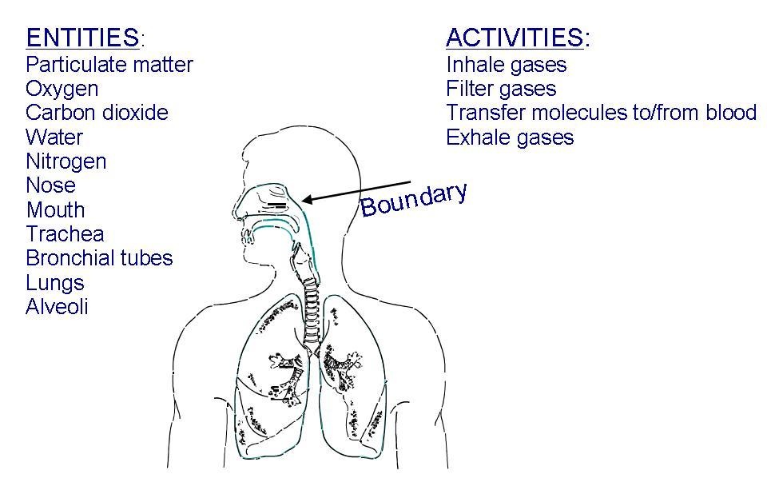
A Systems Approach (Contd.)
Example of systems: a human respiratory system
??

Slide 43
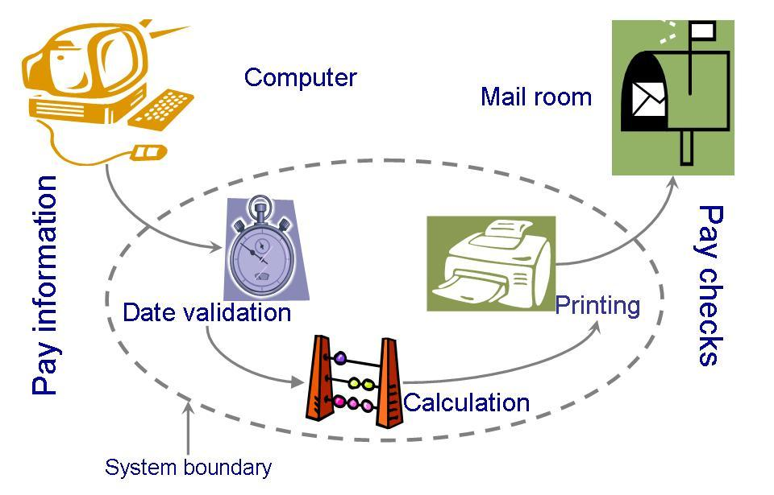
A Systems Approach (Contd.)
A computer system must also be clearly described: System definition of a paycheck production

Slide 44
A Systems Approach (Contd.)
Interrelated Systems:
Some systems are dependent to other systems
The interdependencies may be complex
It is possible for one system to exist inside another system
If the boundary definitions are detailed, building a larger system from the smaller ones is relatively easy

Slide 45
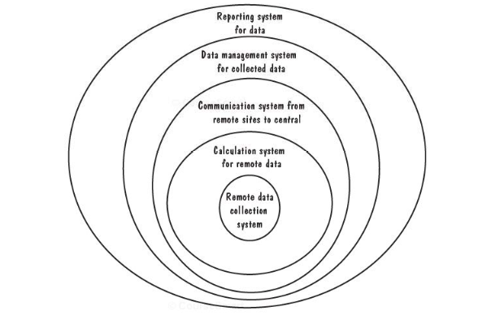
A Systems Approach (Contd.)
Interrelated Systems:

Slide 46
Lecture 3

Slide 47
An Engineering Approach
Idea to build a house
Asking someone to build the house
Explaining requirements
Getting designs
Modifying + Approving designs
Inspecting the construction
Adding new features
Testing household components
Moving in
Getting issues fixed after moving in
Building a House

Slide 48
An Engineering Approach
Determine and Analyze Requirements
Produce and Document Overall Design
Produce Detailed Specifications
Identify and Design Components
Build Components
Test Components
Integrate Components
Make final modifications after residents move in
Continue Maintenance by the Residents
Building a House

Slide 49
An Engineering Approach
Requirement analysis and definition
System design
Program design
Writing the programs
Unit testing
Integration testing
System testing
System delivery
Maintenance
Building a System

Slide 50
Development Team
Requirement analysts: work with the customers to identify and document the requirements
Designers: generate a system-level description of what the system is supposed to do
Programmers: write lines of code to implement the design
Testers: catch faults
Trainers: show users how to use the system
Maintenance team: fix faults that show up later
Librarians: prepare and store documents such as software requirements
Configuration management team: maintain correspondence among various artefacts

Slide 51
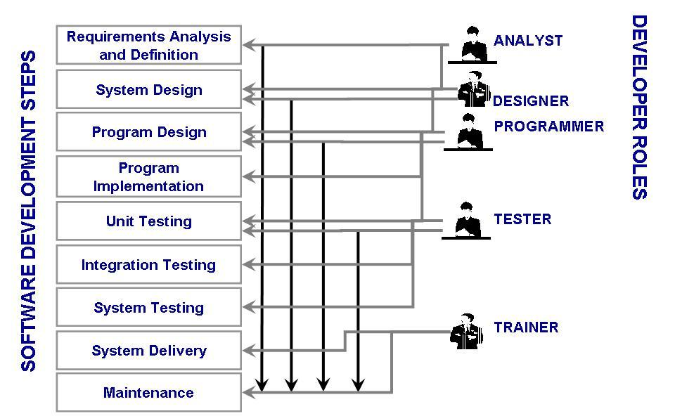
Development Team (Roles)
Who Does What?

Slide 52
How has SE Changed?
Before 1970s
Single processors: mainframes
Designed in one of two ways
as a transformation: input was converted to output
as a transaction: input determined which function should be performed
After 1970s
Run on multiple systems
Perform multi-functions

Slide 53
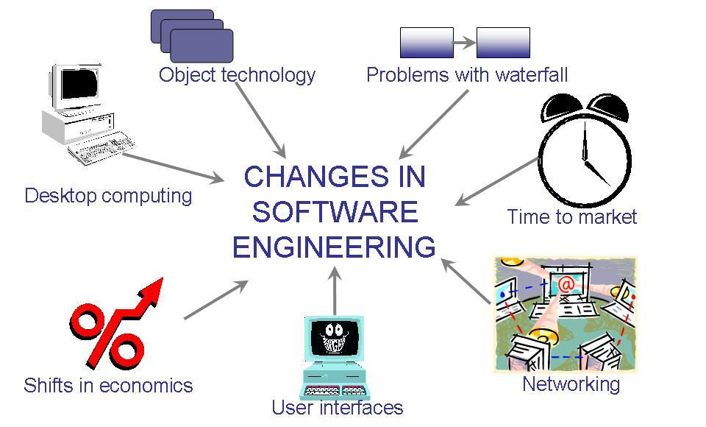
How has SE Changed? (Contd.)
The key factors that have changed the software development
Wasserman’s View

Slide 54
How has SE Changed? (Contd.)
Abstractions
Analysis and design methods and notations
User interface prototyping
Software architecture
Software process
Reuse
Measurement
Tools and integrated environments
Wasserman’s Discipline of Software Engineering

Slide 55
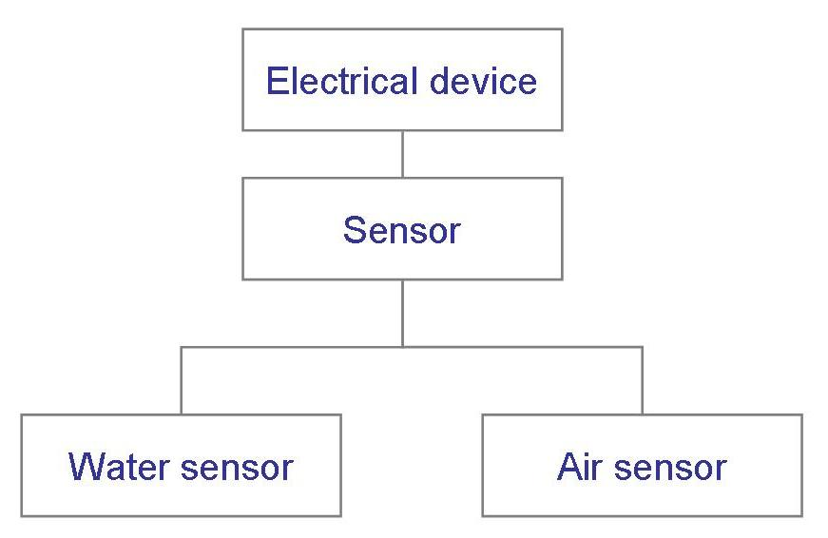
How has SE Changed? (Contd.) Wasserman’s Discipline
Abstractions
Hide details
A description of the problem at some level of generalization

Slide 56
How has SE Changed? (Contd.) Wasserman’s Discipline
Analysis and Design Methods and Notations
Provide documentation
Facilitate communication
Offer multiple views
Unify different views

Slide 57
How has SE Changed? (Contd.) Wasserman’s Discipline
User Interface Prototyping
Prototyping: building a small version of a system
Help users identify key requirements of a system
Demonstrate feasibility
Develop good user interface

Slide 58
How has SE Changed? (Contd.) Wasserman’s Discipline
Software Architecture
A system’s architecture describes the system in terms of a set of architectural units and relationships between these units
Architectural decomposition techniques
Modular decomposition
Data-oriented decomposition
Event-driven decomposition
Outside-in-design decomposition
Object-oriented decomposition

Slide 59
How has SE Changed? (Contd.) Wasserman’s Discipline
Software Process
Many variations
Different types of software need different processes
Enterprise-wide applications need a great deal of control
Departmental applications can take advantage of rapid development

Slide 60
How has SE Changed? (Contd.) Wasserman’s Discipline
Software Reuse
Commonalities between applications may allow reusing artefacts from previous developments
Improve productivity
Reduce costs
Potential concerns
It may be faster to build a smaller application than searching for reusable components
Generalized components take more time to build
Must clarify who will be responsible for maintaining reusable components
Generality vs specificity: always a conflict

Slide 61
How has SE Changed? (Contd.) Wasserman’s Discipline
Tools and Integrated Environments
Platform integration (on heterogeneous networks)
Presentation integration (commonality of user interface)
Process integration (linking tools and the development process)
Data integration (to share common data)
Control integration (the ability of one tool to initiate action in another one)

Slide 62
Information Systems Example Piccadilly System
Piccadilly Television: regional British TV franchise
Advertising scheme has many constraints:
alcohol adverts only after 9 pm
if actor in show, no same actor in advert within 45 minutes
if advert in a class of products, no other advert in same class during same break
rates dependent on amount of time bought
Software to determine, track advertising time

Slide 63
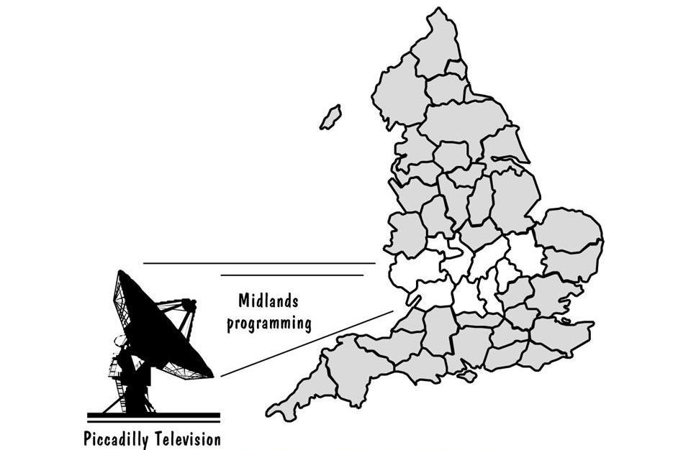
Information Systems Example Piccadilly System (continued)
Piccadilly Television franchise area

Slide 64
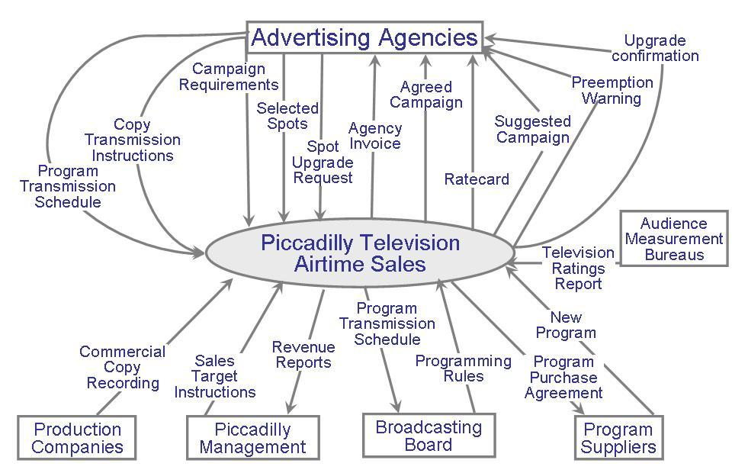
Information Systems Example Piccadilly System (continued)
Piccadilly system’s context diagram

Slide 65
Real Time Example
Ariane-5 rocket, from the European Space Agency
June 4, 1996: functioned well for 40 seconds, then veered off course and was destroyed
Contained four satellites: cost was $500 million
Reused code from Ariane-4 rocket

Slide 66
Real Time Example Ariane-5 Definition of Quality
From the Lions et al report:
“… demonstrated the high quality of the Ariane-5 programme as regards engineering work in general and completeness and traceability of documents.”
“… the supplier of the SRI … was only following the specification given to it. … The exception which occurred was not due to random failure but a design error.”

Slide 67
What this Chapter Means for You
Given a problem to solve
Analyze it
Synthesize a solution
Understand that requirements may change
Must view quality from several different perspectives
Use fundamental software engineering concepts (e.g., abstractions and measurements)
Keep system boundary in mind

Slide 68
Special THANK FOR THE MATERIALS
Pfleeger’s Book slides from UCF
Software Fundamentals

Slide 69
Dictionary has all the words, can you write a novel using those words? This is called the problem of
Integration
Synthesis
Both
none

Slide 70
The mistake made by human is called
Error
Fault
failure

Slide 71
The error creates ____ in software
Error
Fault
failure

Slide 72
The fault in the software result in ____ according to the end user
Error
Fault
failure

Slide 73
It seems good but I don’t know the reason
Transcendental view
User view
Manufacturing view
Product view
Business view

Slide 74
It fulfills my personal choice, so it is good
Transcendental view
User view
Manufacturing view
Product view
Business view

Slide 75
Its engineering design is perfect. So I like it
Transcendental view
User view
Manufacturing view
Product view
Business view

Slide 76
Its gives me lot of profit, so it is fantastic
Transcendental view
User view
Manufacturing view
Product view
Business view

Slide 77
Its does not have any failure. i.e. the results are according to the user’s expectations
Transcendental view
User view
Manufacturing view
Product view
Business view

Slide 78
The core objective of ood is
Efficiency
Abstraction
Reusability
All
none

Slide 79
2+2 = 5 is correct if clients wishes so
True
false

Slide 80
___ uses the software
Users
Customers
Both
none

Slide 81
___ signs contract with the developers
Users
Customers
Both
none

Slide 82
For good software design we need to properly define system______

Slide 83
Maximum possible output with minimum possible input is called ___
Reliability
Efficiency
Integrity
maintainability

Slide 84
If the results at Time 1 and time 2 are same , the application has ____
Reliability
Efficiency
Integrity
maintainability

Slide 85
If we can update a module without disturbing other modules of a system, the feature is called ________
Reliability
Efficiency
Integrity
maintainability

Slide 86
If it is very hard to intrude into software private data, the feature is called
Reliability
Efficiency
Integrity
maintainability

Slide 87
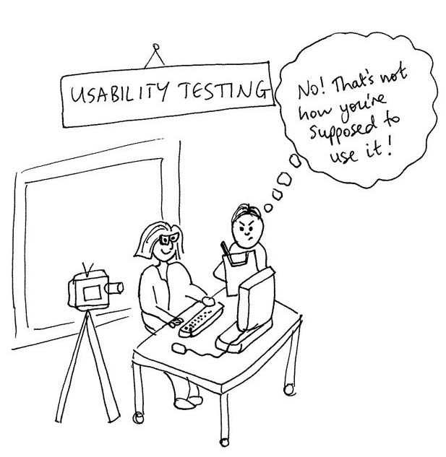

Slide 88


Slide 89
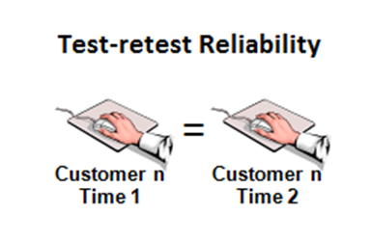

Slide 90
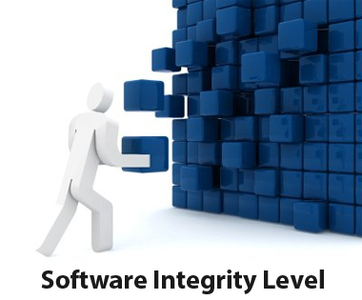

Slide 91
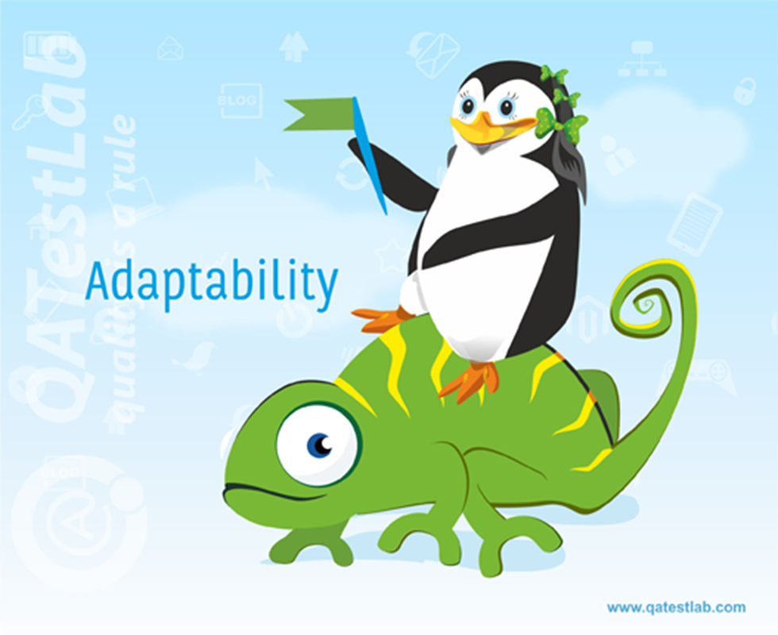

Slide 92


Slide 93
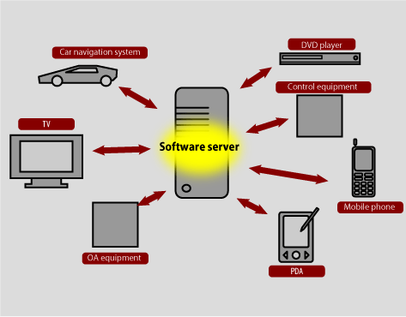

Slide 94
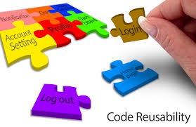

Slide 95


